Slide 1

K-Nearest Neighbors
11/3/2021

Slide 2
Lesson Plan
Classification
K-Nearest Neighbors
How to choose K
Types of Distances

Slide 3
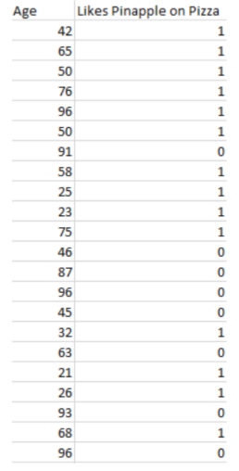
Classification
Discrete value output
Binary Classification
Two Possible Values can be guessed
Standard practice: label as 0 or 1
Multiclass Classification
More than 2 values can be guessed

Slide 4
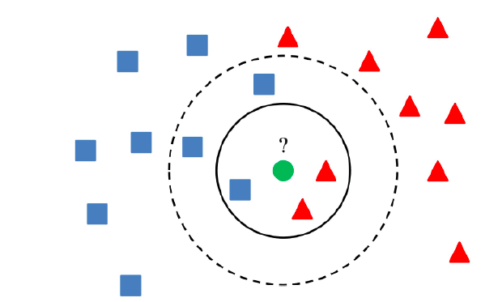
K-Nearest Neighbors
Search through the training set
Look at the K nearest instances
An unknown instance becomes
the majority

Slide 5
How to choose K
Usually odd number (for majority voting)
Low K value: less stable predictions, noise/outliers are a problem
High K value: more accurate predictions, computationally expensive
Make plot of error rate vs K value to find optimal K

Slide 6
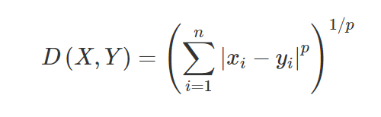
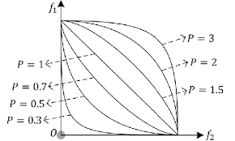
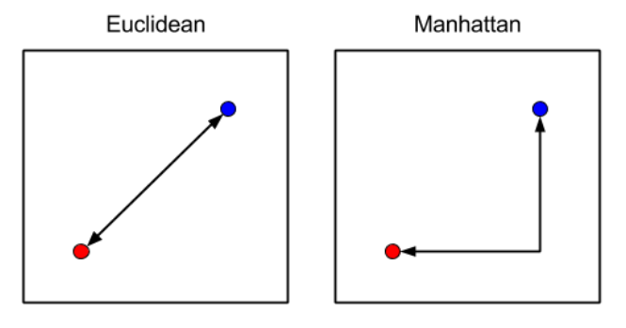
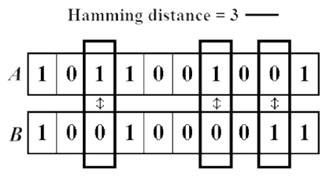
Types of Distances
Euclidean distance
Hamming distance (for binary)
Manhattan distance
Minkowski distance

